Slide 1
Drug vs Placebo for Cirrhosis
Jalicia Harris

Slide 2
Introduction
Conducted research and analysis of data from 10-year (1974-1984) Mayo Clinic trial of patients that participated in a randomized placebo-controlled trial of the drug D-penicillamine.
Stakeholder: The Mayo Clinic
Business question: What machine learning model could best predict which patients where prescribed D-Penicillamine, a placebo, or did not participate in the trial but provided medical information?

Slide 3
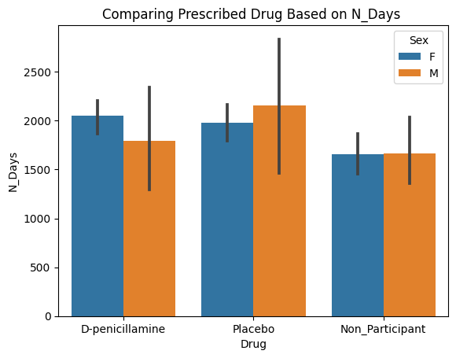
Visual Representation of Analytical Insights
The bar plot shows that male patients who were prescribed the drug, D-penicillamine, spent the least number of days participating in the trial.
This could be due the drug improving the cirrhosis of those patients.

Slide 4
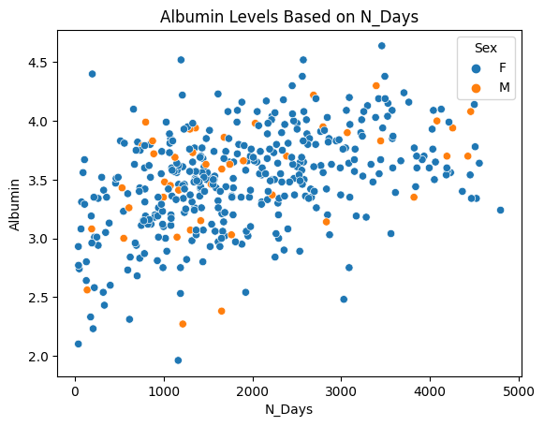
…Continued
The scatter plot shows that most patients’, both male and female, albumin levels gradually increased throughout trial.
Many factors could cause this including the prescribed drug, consistent medical observation, etc.

Slide 5
Machine Learning Production Model
The KNN tuned model would be the best model for making predictions of whether a patient was prescribed D-penicillamine, a placebo, or didn't participate in the clinical trial but provided medical information. Although the test scores fall by 3%, both train and test metrics are higher than any of the models.
Limitations:
Although the model performs very well on making predictions of which patients were prescribed D-penicillamine, it does poorly on predicting which patients were given a placebo.
This could affect patients by causing their medical information to be incorrect, thus potentially causing their treatment plan to be incorrect as well.

Slide 6
Final Recommendations
Based on the extensive analysis of the data, patients who didn't take part in the trial should be removed or replaced with participants as not to possibly skew the test results.
Test results including vitals, overall health, etc., after the trial was completed could be added to the dataset for better prediction making.

Slide 7
Any Questions?

